Slide 1
Machine Learning
From Supervised Learning to Applications
NSW HSC Software Engineering | Software Automation | 2022 NESA Syllabus
Knox Grammar School — TAS Faculty

Slide 2
The Logical Chain — How the Four Concepts Connect
LAYER 1
LAYER 2
LAYER 3
LAYER 4
Supervised Learning
Design & Analyse Models
Algorithm Types
Common Applications
• Labelled training data
• Input paired with correct output
• Focus pathway for software engineers
• Decision Trees
(branching rule-based)
• Neural Networks
(training + execution cycle)
• Linear Regression • Logistic Regression • K-Nearest Neighbour
• Data Analysis &
Forecasting
• Virtual Personal Assistants
• Image Recognition
→
→
→
Read each layer in order — every layer feeds directly into the next

Slide 3
Layer 1 — Supervised Learning: The Foundation
DEFINITION
Labelled Data Required
In supervised learning, the system is trained on a labelled dataset — a collection of examples where each input is paired with the correct output answer. The machine learns to map inputs to outputs by minimising the error between its predictions and the known correct answers.
Each training example has an input (features or measurements) and a correct output (the label). Example: a house listing + its sale price.
The Machine Learns a Mapping
The system repeatedly adjusts its internal parameters to minimise the gap between its prediction and the correct answer.
Why Supervised Learning is the Focus Pathway for SEs
Decision trees and neural networks (Layer 2) are both supervised model architectures.
Linear regression, logistic regression, and KNN (Layer 3) are all supervised algorithms.
All three applications (Layer 4) are deployed supervised learning systems.
Generalises to New Data
Once trained, the model predicts outputs for new, unseen inputs it has never encountered. This is the system in deployment.

Slide 4
Layer 2 — Model: Decision Trees
DEFINITION
Credit > 700?
A decision tree represents all possible combinations of decisions as a branching structure. Each internal node tests an input feature, each branch represents the outcome of that test, and each leaf node produces a final classification or predicted value.
Yes
No
Income > $60k?
Employed?
Yes
No
Yes
No
APPROVE
DECLINE
APPROVE
DECLINE
How a Software Engineer Uses a Decision Tree
Example: Bank Loan Approval Decision Tree
The SE determines:
• Which features to test at each node
• The condition for branching (e.g. score > 70)
• How deep the tree runs
• What classification each leaf outputs
Once designed, logistic regression or KNN (Layer 3) determines the optimal split condition during training.

Slide 5
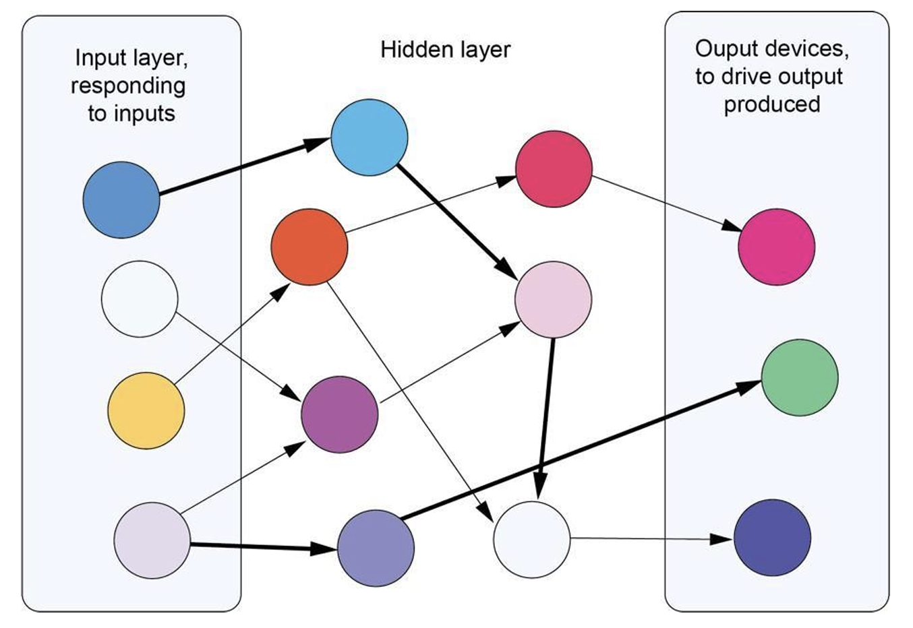
Layer 2 — Model: Neural Networks
DEFINITION
A neural network mimics the processing of the human brain. It consists of a series of interconnected nodes (artificial neurones) arranged in an input layer, one or more hidden layers, and an output layer. Each neurone accepts a weighted input and potentially passes a signal to the next layer.
Training Cycle
The network is exposed to labelled inputs with known correct responses.
Internal weightings and threshold values for each node are determined iteratively.
Linear regression with backward chaining adjusts weightings layer by layer, minimising prediction error.
Neural Network Structure
Execution Cycle
Follows the training cycle. The established weightings are fixed and applied to new, unseen inputs. Nodes with the strongest weightings carry higher priority in determining the final output. Weightings are NOT modified — they are applied.
Exam phrase: "Linear regression with backward chaining" — this exact phrase is required in Band 5-6 responses about neural network training.

Slide 6
Layer 3 — Algorithm Types: The Three Outputs of Model Training
Once a decision tree or neural network is designed and trained, it produces predictions through one of three algorithm types. The algorithm determines the type of output — and therefore the application.
01 Linear Regression
02 Logistic Regression
03 K-Nearest Neighbour
Output Type
Output Type
Output Type
Continuous numeric value
Category / class label
Category by similarity
e.g. predicted price, score, temperature
e.g. Approve / Decline, Spam / Not Spam
e.g. malignant / benign, defect / pass
How it works:
How it works:
How it works:
Fits a straight line (or curve for polynomial regression) through training data. Assumes a linear relationship between inputs and the target variable.
Outputs the probability of belonging to a class. Uses a threshold (e.g. 0.5) to assign the category with the highest probability.
Finds the K most similar labelled examples in training data (using Euclidean distance). Assigns the majority class among those K neighbours.
→ Application: Data Analysis
& Forecasting
→ Application: Virtual Personal
Assistants
→ Application: Image
Recognition

Slide 7
Layer 3 → Layer 4 — Linear Regression: Data Analysis & Forecasting
DEFINITION — LINEAR REGRESSION
Application — Data Analysis & Forecasting
Predicts a continuous numeric output value by fitting a line of best fit through the training data. Assumes a linear relationship between input features and the target variable. Polynomial regression extends this to curved, non-linear relationships.
A retail chain trains a linear regression model on historical weekly sales figures, seasonal indicators, and promotional data.
The model predicts required stock levels for the coming week — a continuous numeric output.
A financial institution uses the same approach to estimate the probability of loan default, producing a risk score.
Output Type
A continuous numeric value — answers the question:
"How much? What price? What score? What temperature?"
Python (scikit-learn)
from sklearn.linear_model import LinearRegression
import numpy as np
x = np.array([[2],[4],[6],[8],[10]]) # hours
Training Algorithm (in Neural Networks)
y = np.array([1, 3, 5, 7, 9]) # scores
model = LinearRegression()
Linear regression with backward chaining is used during the neural network training cycle to adjust internal node weightings.
model.fit(x, y) # training cycle
model.predict([[4.5]]) # execution → [3.5]

Slide 8
Layer 3 → Layer 4 — Logistic Regression: Virtual Personal Assistants
DEFINITION — LOGISTIC REGRESSION
Application — Virtual Personal Assistants (e.g. Siri, Google Assistant)
A classification algorithm — not a numeric predictor. It outputs the probability that an input belongs to one of a discrete set of categories, and assigns the class with the highest probability. A threshold (typically 0.5) converts the probability to a class label.
Step 1 — Speech to Text
Neural network (trained with linear regression + backward chaining) converts the audio signal into a text string.
↓
Step 2 — Intent Classification
Output Type
Logistic regression classifies the recognised phrase into a command category: 'set timer', 'play music', 'send message'. Output = a class label.
A category or class label — answers the question:
"Which group? Yes or No? Spam or Not Spam? High or Low risk?"
↓
Step 3 — Parameter Extraction
A further model extracts numeric or named entities: '5 minutes', 'The Beatles'. Each stage is a separately trained supervised model.
Common Mistake to Avoid
↓
Result
Logistic regression is NOT a numeric predictor. The word 'regression' refers to the sigmoid function used internally — the OUTPUT is always a class, not a quantity.
The user hears a seamless spoken response — the result of three supervised ML models working in sequence.

Slide 9
Layer 3 → Layer 4 — K-Nearest Neighbour: Image Recognition
DEFINITION — K-NEAREST NEIGHBOUR (KNN)
Application — Image Recognition
Classifies a new data point by finding the K most similar labelled examples in the training dataset (measured using Euclidean distance) and assigning the majority class among those K nearest neighbours. Makes no assumption about the functional relationship between inputs and outputs.
Malignant (training)
Benign (training)
New scan (unknown)
Pathology tumour classification — KNN finds K most similar training scans
Output Type
A category based on similarity to known examples. Answers the question:
"Which labelled example in the training set does this most resemble?"
Key Difference vs Linear Regression
Linear regression: assumes a linear relationship, fast at prediction time.
KNN: no assumption, handles non-linear patterns, computationally expensive at prediction time.
K=5 neighbours: 4 malignant, 1 benign
→ Classified as: MALIGNANT

Slide 10
Exam-Ready Summary — Write These Two Paragraphs
Supervised Learning, Models & Training Cycle
Supervised learning is the primary training model used when software engineers develop machine learning systems. In supervised learning, the system is trained on a labelled dataset in which each input example is paired with its correct output answer. The machine learns to map inputs to outputs by minimising the difference between its predictions and the known correct answers. To design and analyse this learning process, software engineers use decision trees or neural networks. A decision tree represents all possible combinations of decisions as a branching structure, where each internal node tests an input feature and each leaf node produces a classification. A neural network mimics the human brain, consisting of interconnected nodes in an input layer, hidden layers, and an output layer. During the training cycle, linear regression with backward chaining iteratively adjusts node weightings to minimise error. During the execution cycle, those fixed weightings are applied to new inputs to generate predictions.
Algorithm Types & Common Applications
Once the model has been designed and trained, it produces predictions through one of three algorithm types. Linear regression predicts a continuous numeric output value by fitting a line of best fit through the training data, and is well suited to data analysis and forecasting — predicting stock demand or property prices. Logistic regression is used for classification problems, outputting the probability that an input belongs to a discrete category; this algorithm is applied in virtual personal assistants to classify recognised spoken phrases into command categories. K-Nearest Neighbour (KNN) classifies a new data point by calculating its distance to the K most similar labelled examples in the training dataset and assigning the majority class, making it effective for image recognition tasks where classification depends on visual similarity to known examples. Together, these algorithm types translate supervised learning patterns into deployed systems capable of solving forecasting, language, and visual classification problems.

Slide 11
Linear regression, polynomial regression, and logistic regression
Linear regression, polynomial regression, and logistic regression are all supervised machine learning algorithms that are trained on labelled data, yet they differ fundamentally in the types of problems they solve and the nature of their output.
Linear regression models the relationship between one or more input features and a continuous output variable by fitting a straight line through the training data, making it appropriate for predicting numeric values such as house prices or temperature readings where a proportional, linear relationship can be assumed. Polynomial regression extends this approach by fitting a curved line using higher-degree polynomial equations, enabling the model to capture non-linear relationships in the data — for example, predicting engine wear over time, where the rate of degradation accelerates rather than increases at a constant rate. Both linear and polynomial regression therefore belong to the same category of regression tasks: they predict values across a continuous numeric range.

Slide 12
Logistic regression, despite its name, operates fundamentally differently; rather than predicting a continuous value, it is used for classification problems and outputs a probability between 0 and 1, which is then mapped to a discrete category. A common application is binary classification, such as predicting whether a patient's test result is positive or negative.
Consequently, the choice between these algorithms depends entirely on the nature of the problem: if the target variable is a continuous number, linear or polynomial regression is appropriate, with polynomial selected when the data exhibits a curved trend; if the target is a categorical outcome, logistic regression is the correct tool.

Slide 13
Feature | Linear Regression | Polynomial Regression | Logistic Regression
Task type | Regression | Regression | Classification
Output type | Continuous numeric value | Continuous numeric value | Probability mapped to a discrete class (e.g. 0 or 1)
Relationship modelled | Straight-line (linear) relationship between input and output | Curved (non-linear) relationship using higher-degree polynomial equations | Non-linear relationship mapped through a sigmoid function to a probability
Line/curve of best fit | Straight line | Curved polynomial curve | S-shaped sigmoid curve
Training data required | Labelled (supervised) | Labelled (supervised) | Labelled (supervised)
When to use | Data follows a consistent, proportional trend | Data follows a curved or accelerating trend | Output is a category, not a number
Real-world example | Predicting a student's exam score from hours studied | Predicting engine wear rate over time | Classifying an email as spam or not spam
Python library | sklearn.linear_model.LinearRegression | sklearn.preprocessing.PolynomialFeatures + LinearRegression | sklearn.linear_model.LogisticRegression
Common error | Applying to curved data, producing poor fit (underfitting) | Overfitting if polynomial degree is too high | Misidentifying it as a regression tool — it is a classifier
HSC syllabus category | Regression algorithm — predicts continuous values | Regression algorithm — predicts continuous values | Classification algorithm — predicts a category

